Slide 1
HxGN MineOperate
Managing Customizations in SSRS/Jview
Edgar Sepulveda
Global Technical Manager, MineOperate
Date 10/10/2022
Version 1.3

Slide 2

Purpose
This session
At the end of this module, you will:

Slide 3
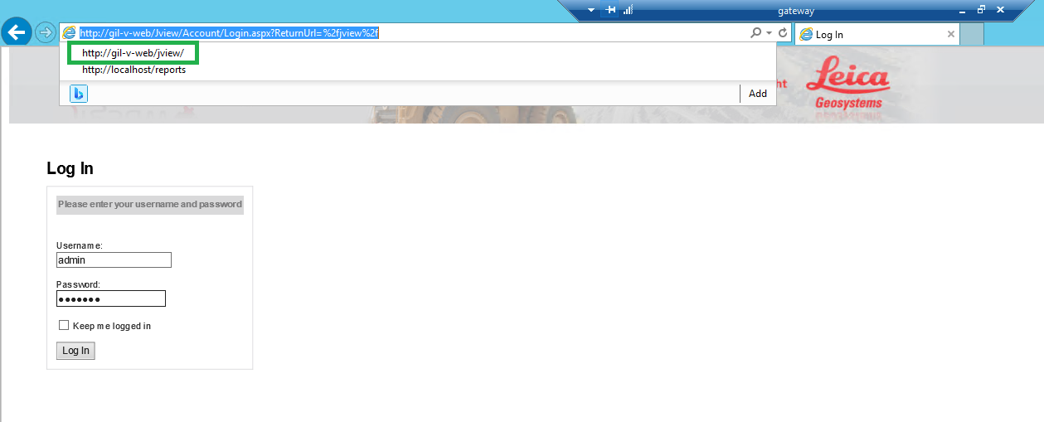
Managing Customizations in SSRS/Jview

Slide 4
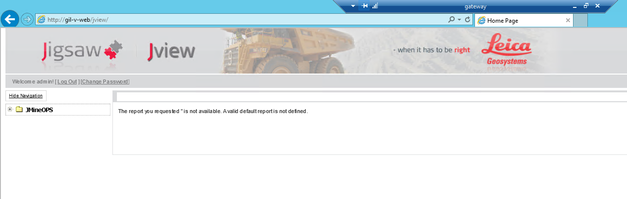
Managing Customizations in SSRS/Jview

Slide 5
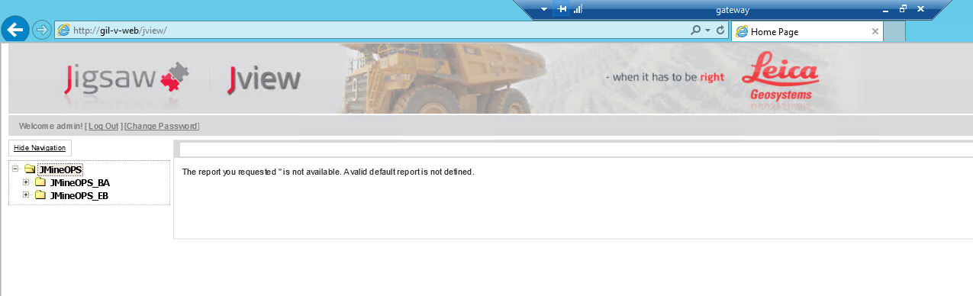
Managing Customizations in SSRS/Jview

Slide 6
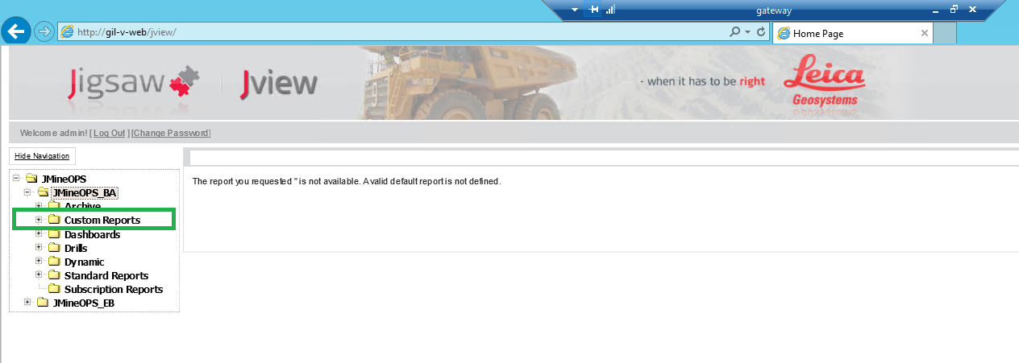
Managing Customizations in SSRS/Jview

Slide 7
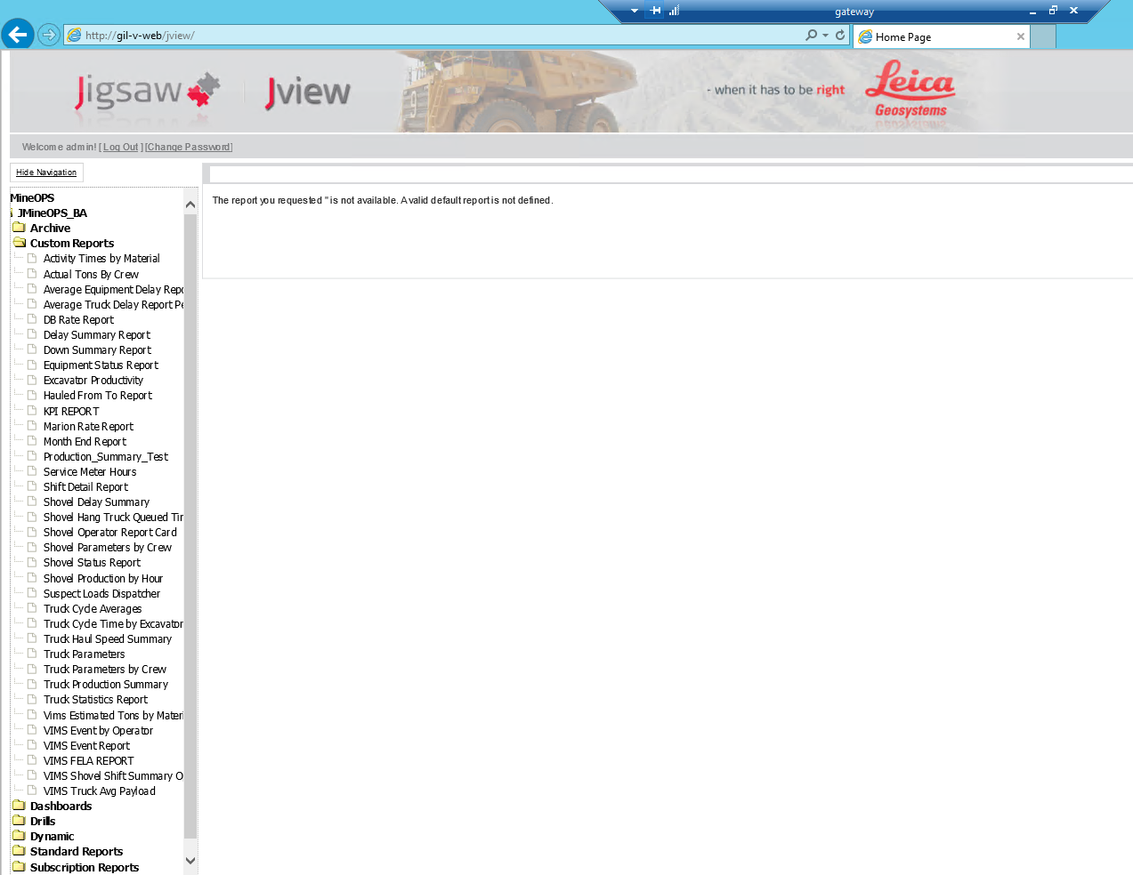
Managing Customizations in SSRS/Jview

Slide 8
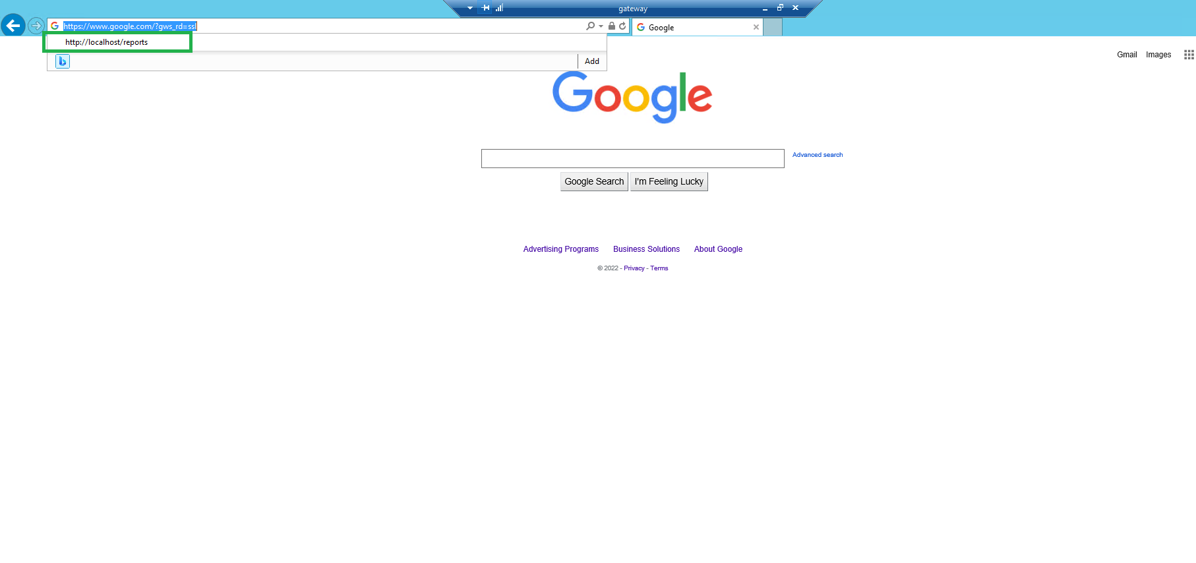
Managing Customizations in SSRS/Jview

Slide 9
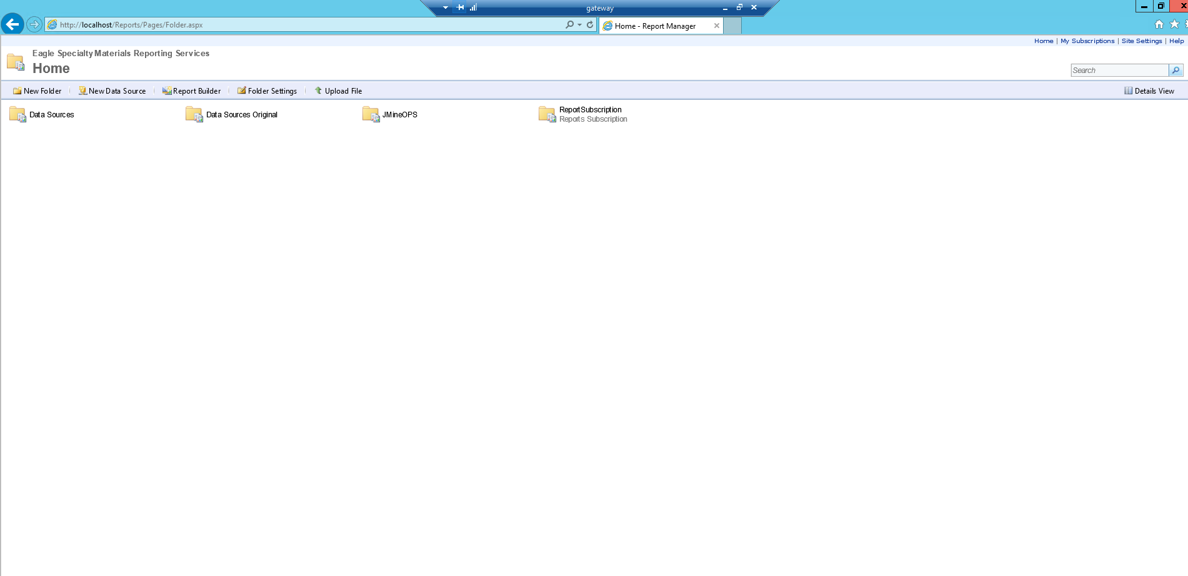
Managing Customizations in SSRS/Jview

Slide 10
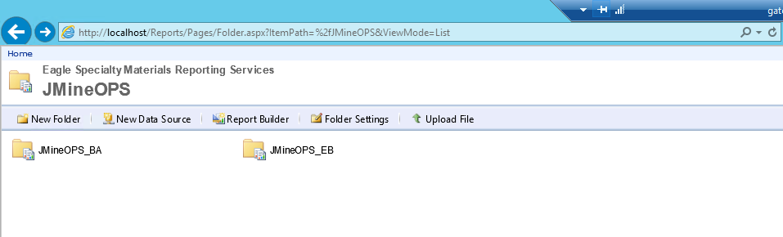
Managing Customizations in SSRS/Jview

Slide 11
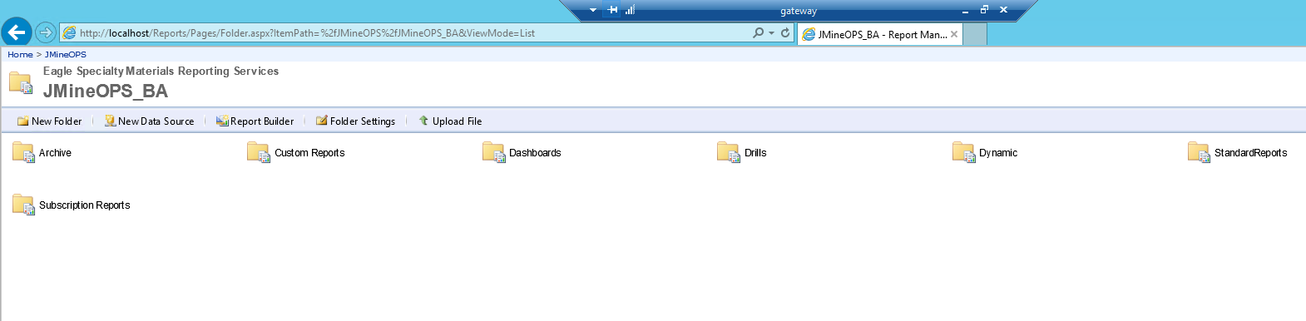
Managing Customizations in SSRS/Jview

Slide 12
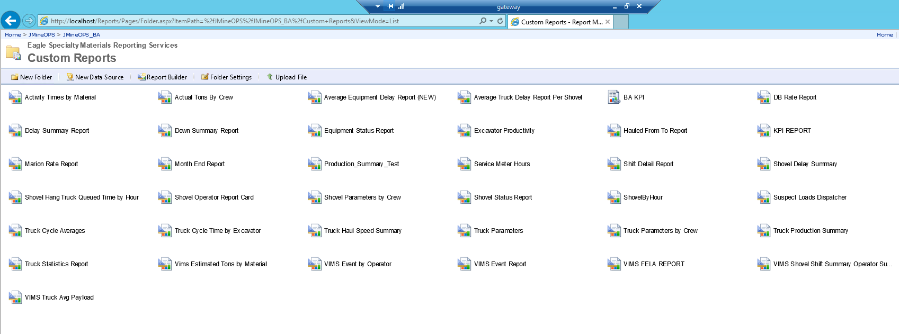
Managing Customizations in SSRS/Jview

Slide 13
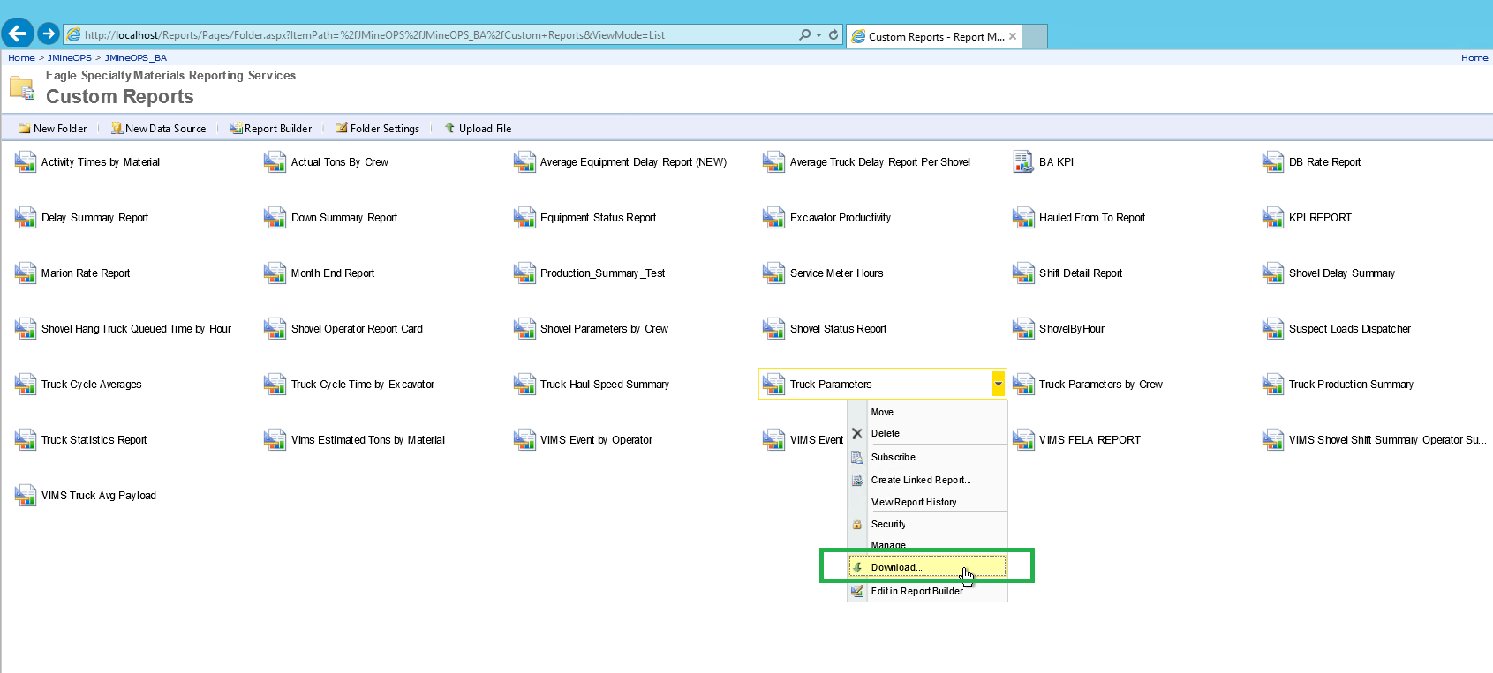
Managing Customizations in SSRS/Jview

Slide 14
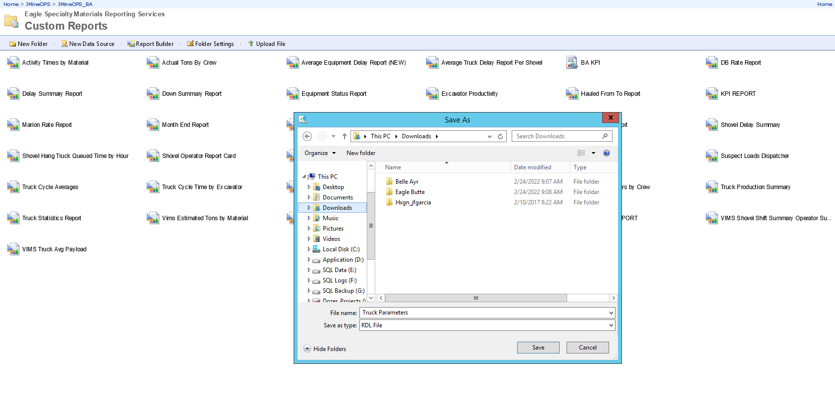
Managing Customizations in SSRS/Jview

Slide 15
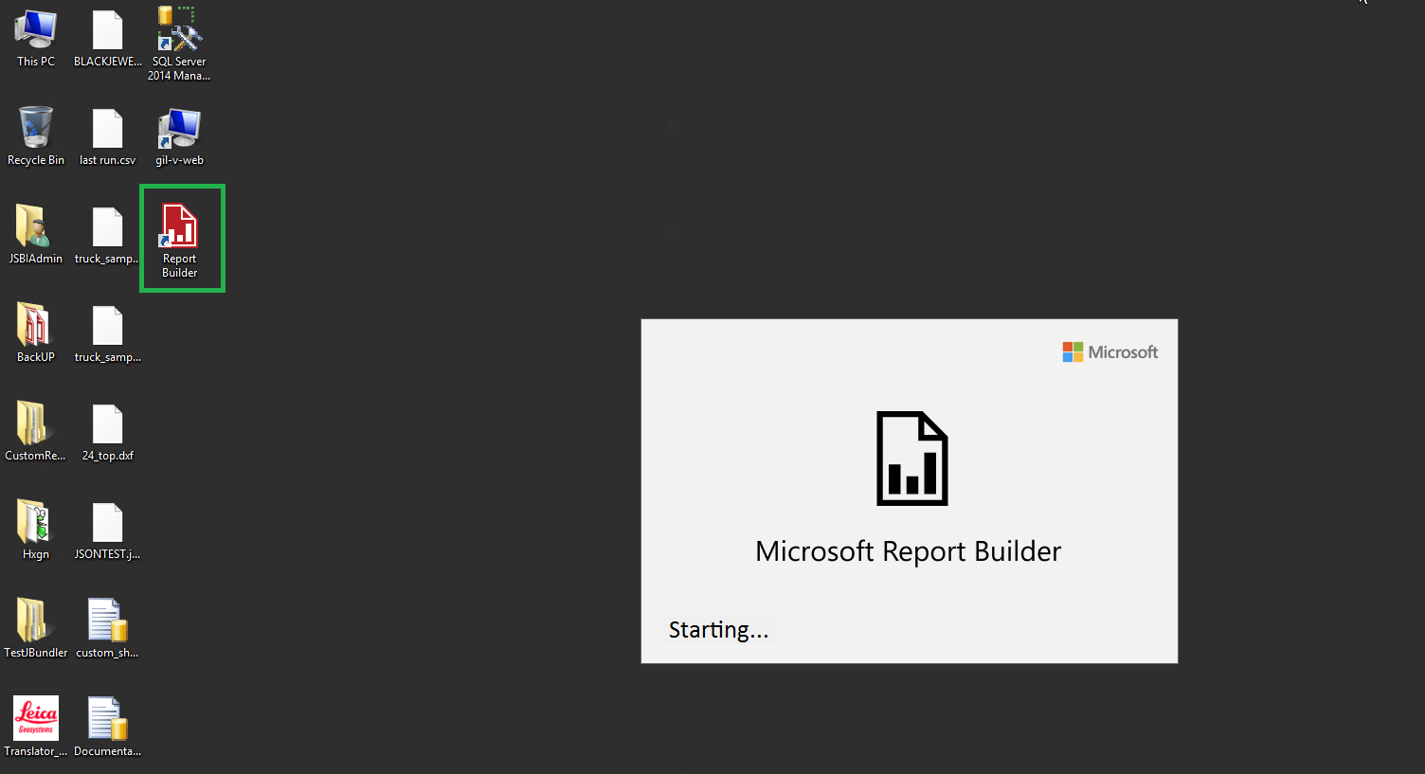
Managing Customizations in SSRS/Jview

Slide 16
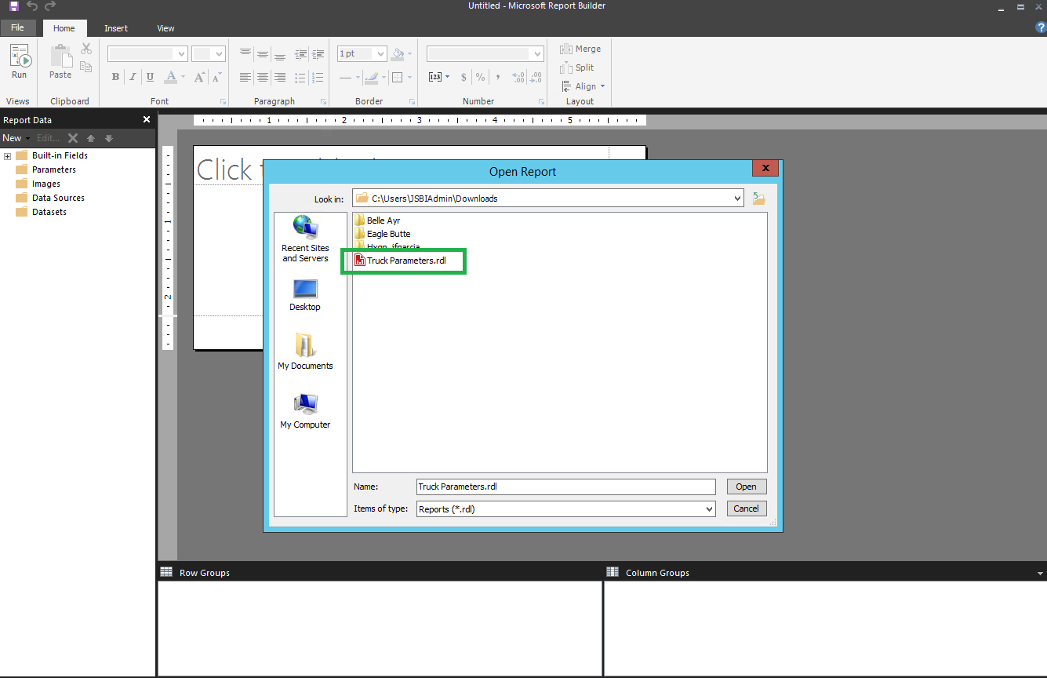
Managing Customizations in SSRS/Jview

Slide 17
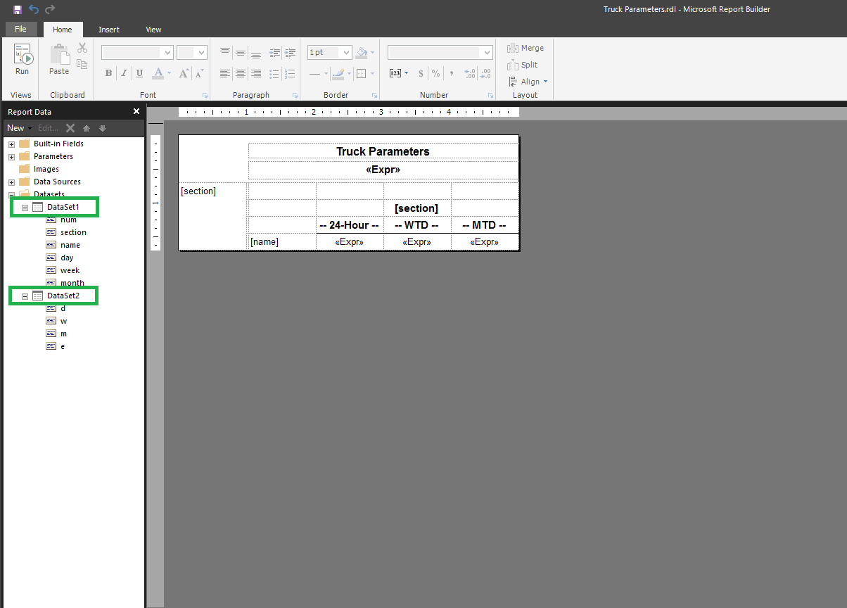
Managing Customizations in SSRS/Jview

Slide 18
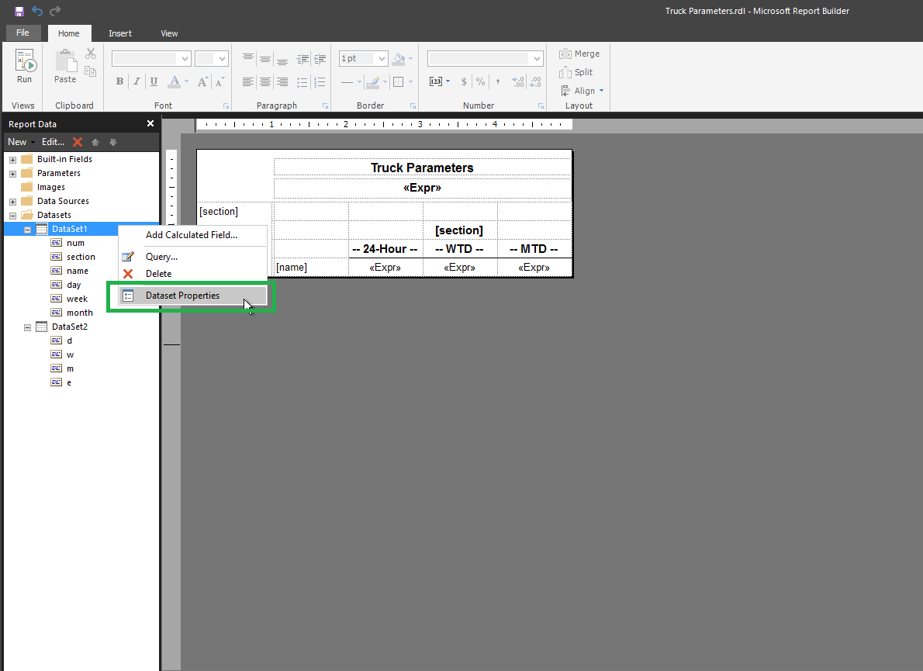
Managing Customizations in SSRS/Jview

Slide 19
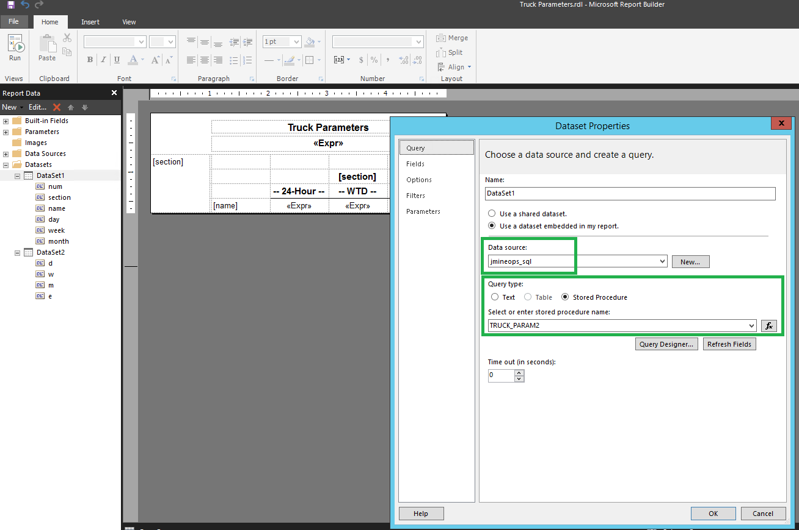
Managing Customizations in SSRS/Jview

Slide 20
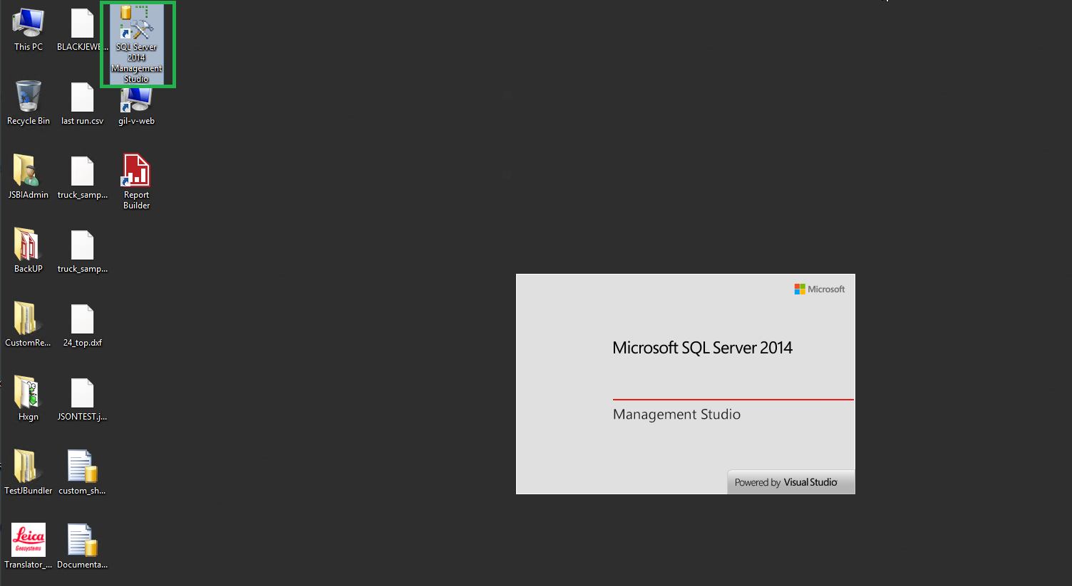
Managing Customizations in SSRS/Jview

Slide 21
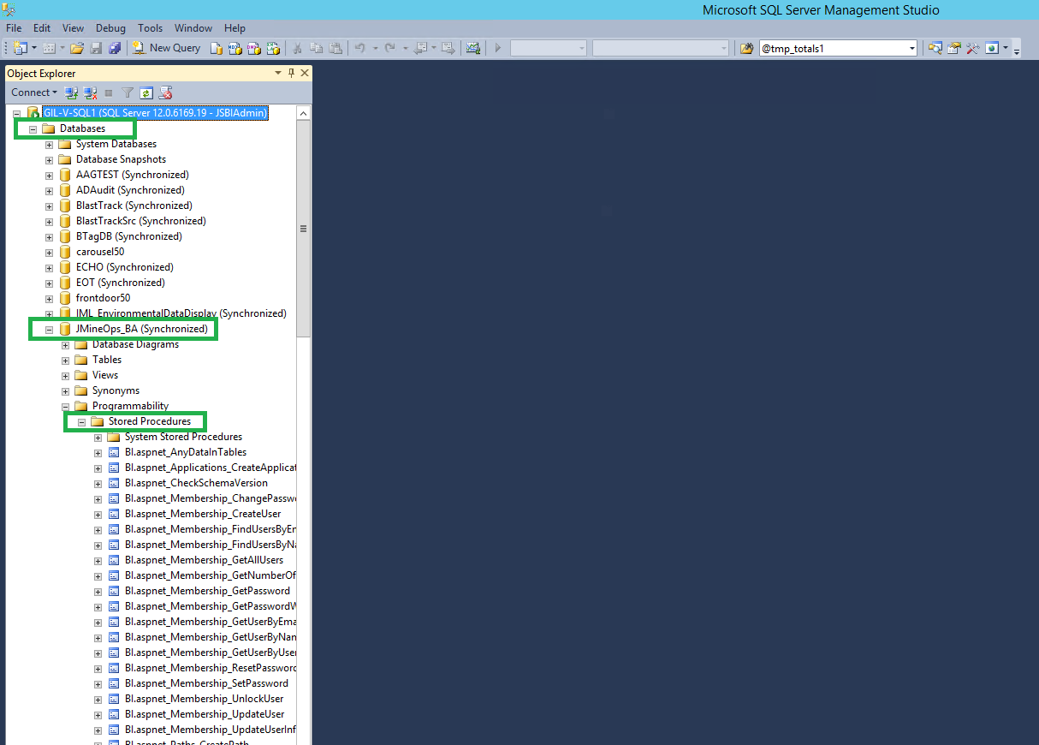
Managing Customizations in SSRS/Jview

Slide 22
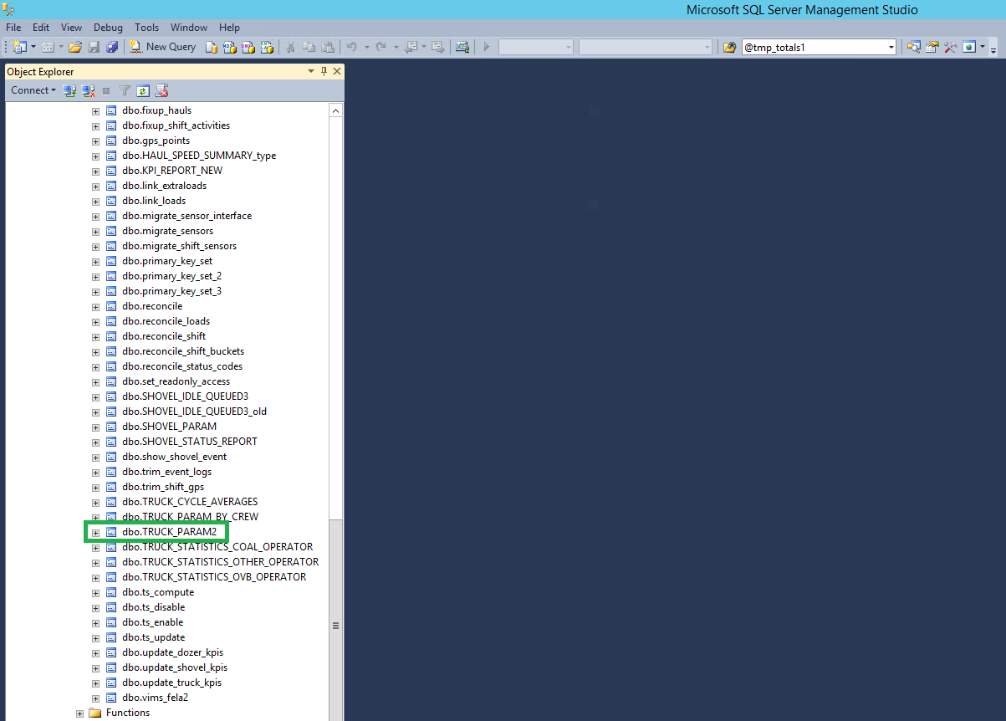
Managing Customizations in SSRS/Jview

Slide 23
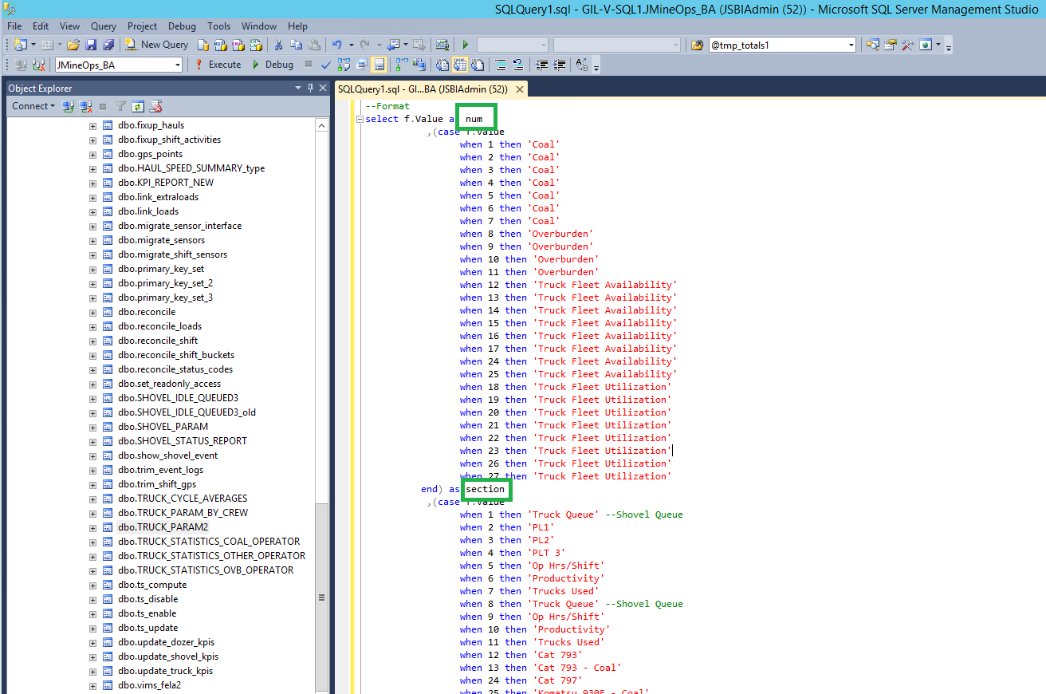
Managing Customizations in SSRS/Jview

Slide 24
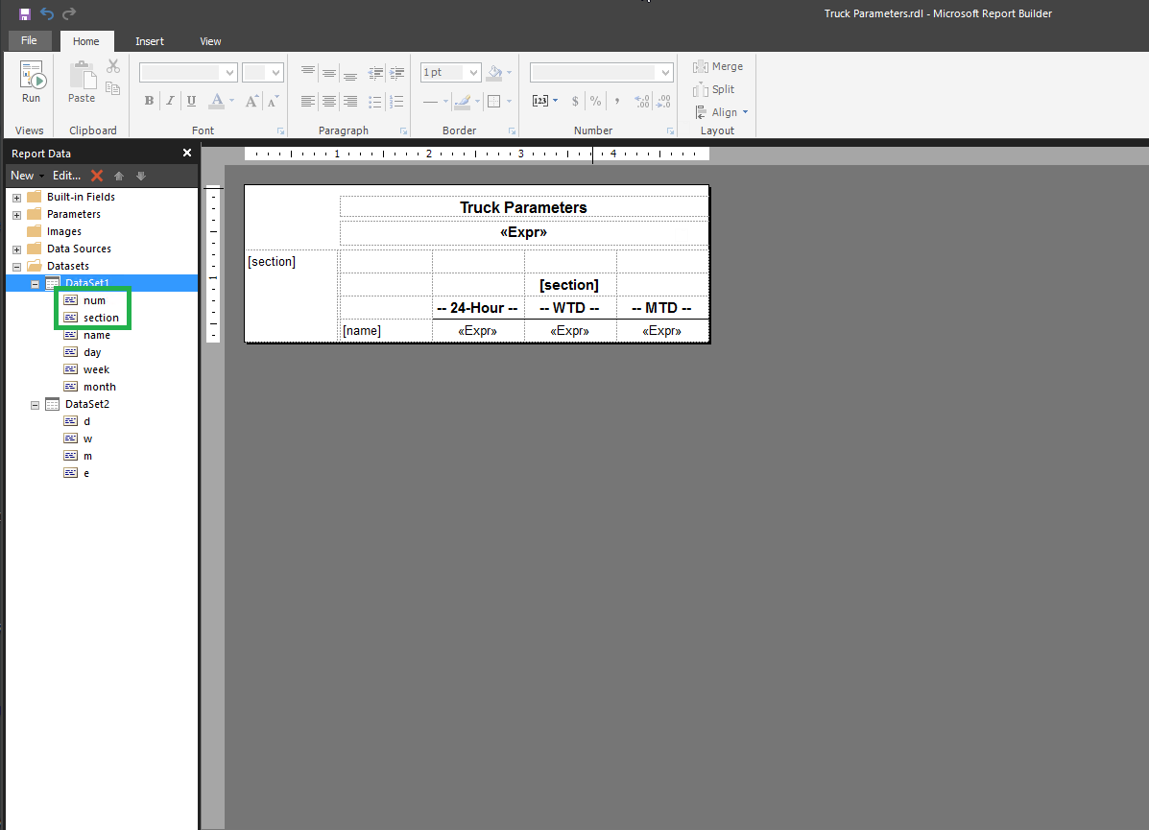
Managing Customizations in SSRS/Jview

Slide 25
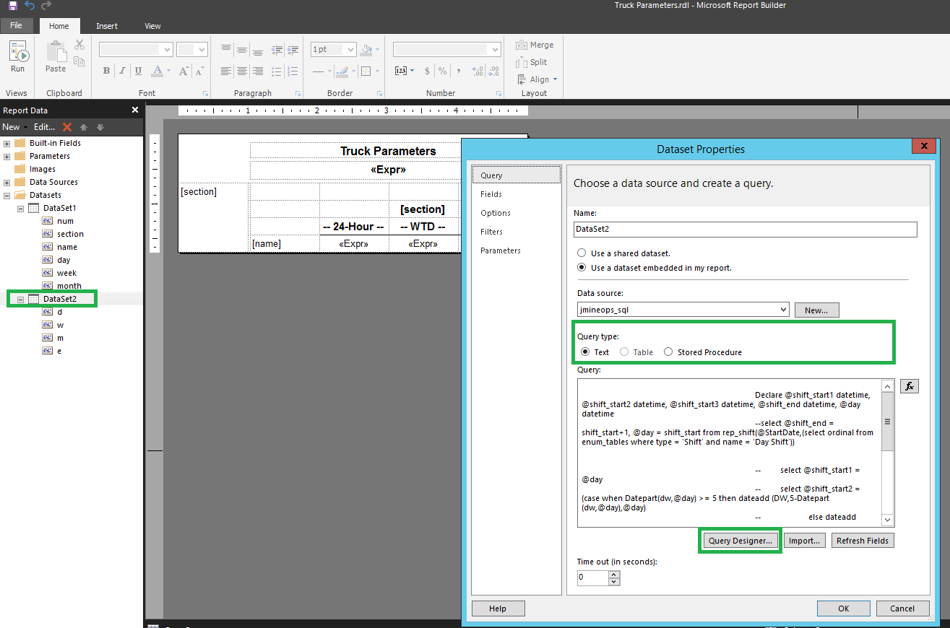
Managing Customizations in SSRS/Jview

Slide 26
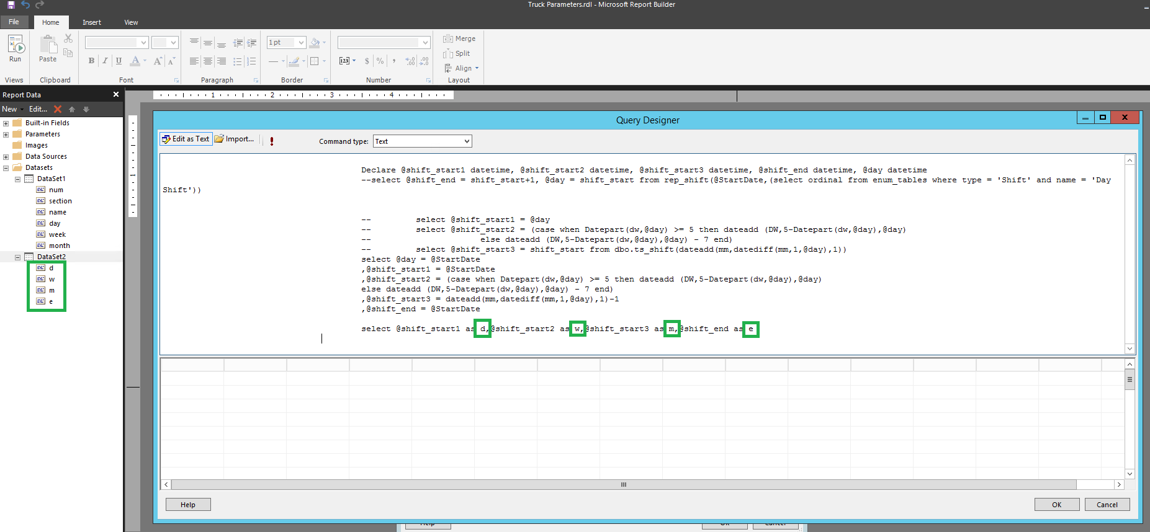
Managing Customizations in SSRS/Jview

Slide 27
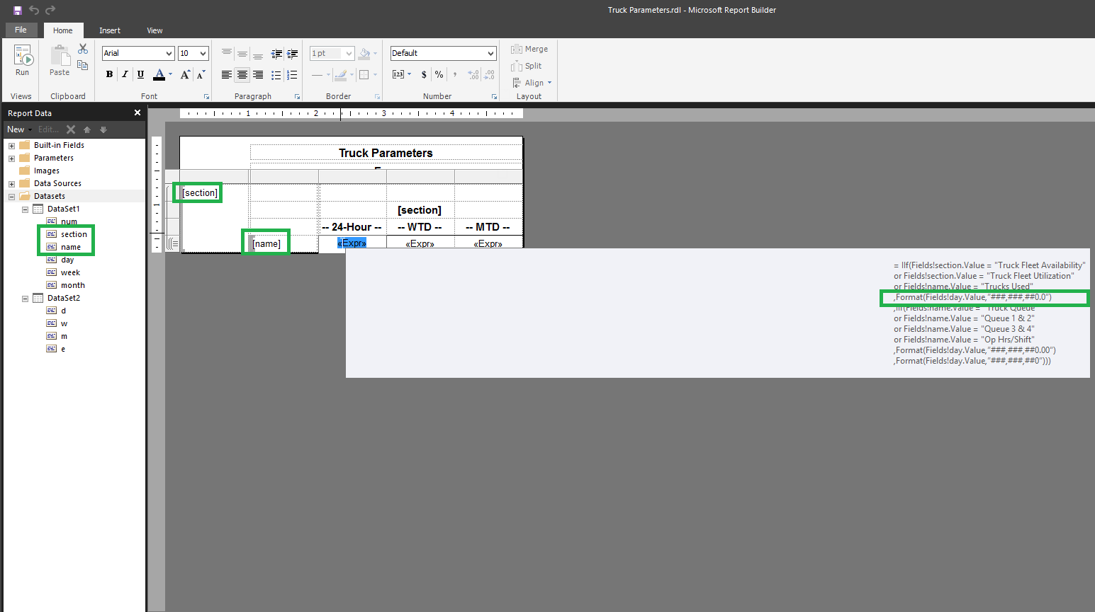
Managing Customizations in SSRS/Jview

Slide 28
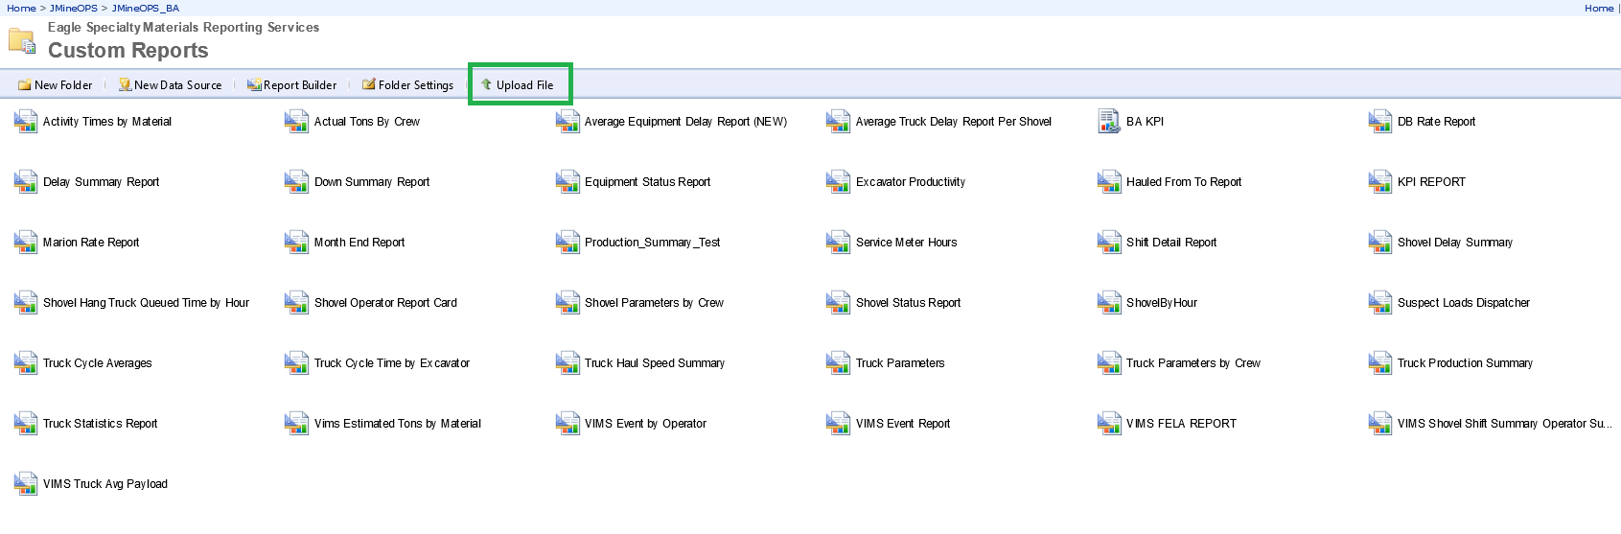
Managing Customizations in SSRS/Jview

Slide 29
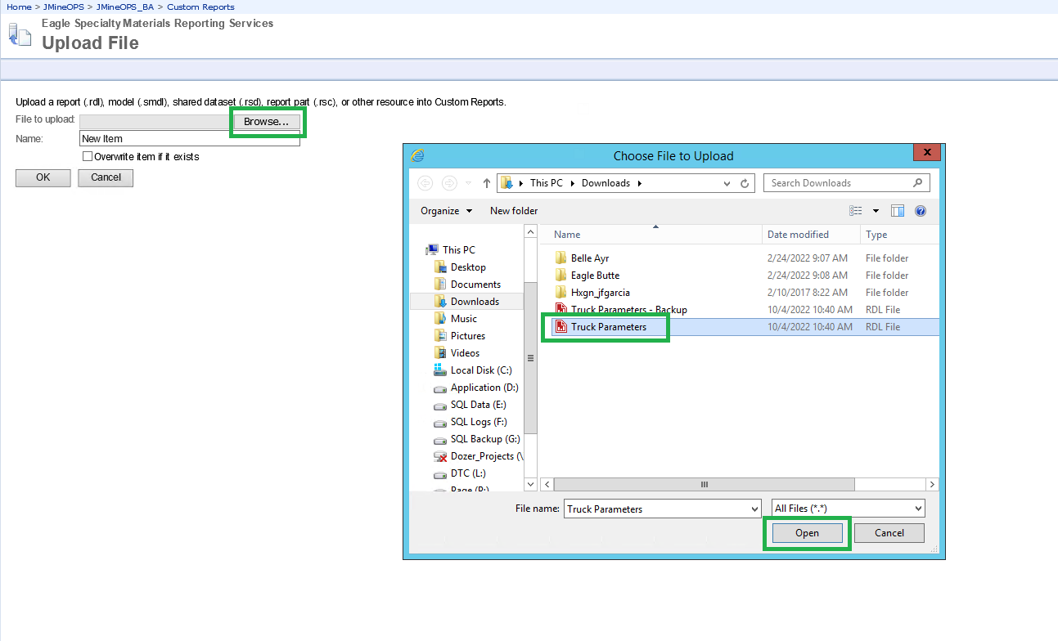
Managing Customizations in SSRS/Jview

Slide 30
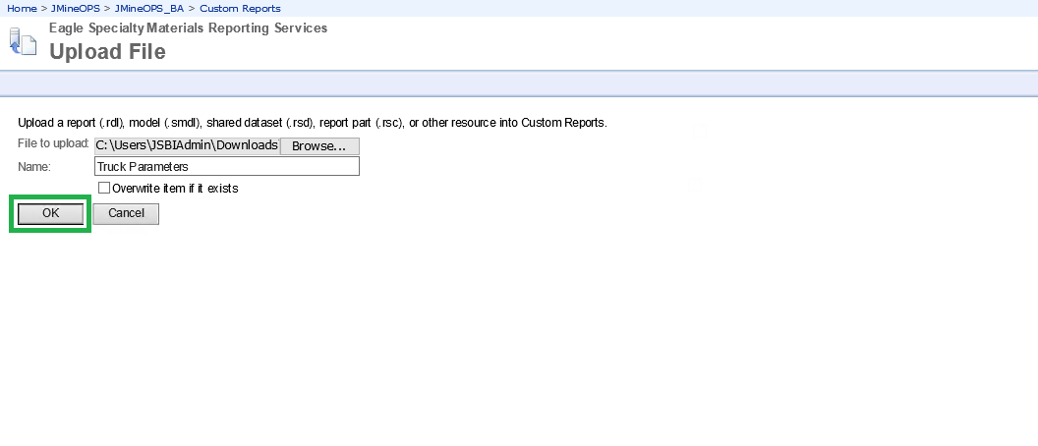
Managing Customizations in SSRS/Jview

Slide 31
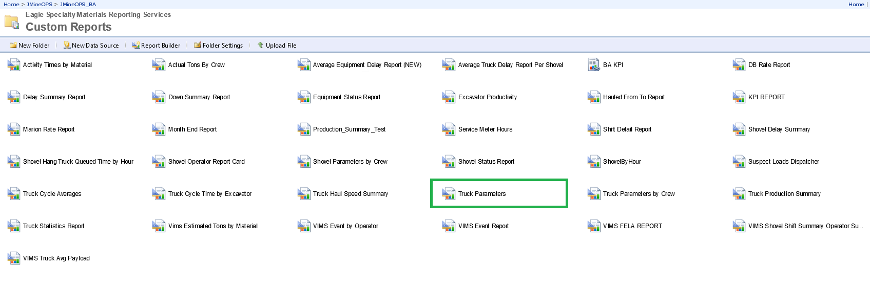
Managing Customizations in SSRS/Jview

Slide 32

THANK
Y
O
U

